Slide 1
Control Logic
CSCI 2050U - Computer Architecture
Randy J. Fortier
@randy_fortier

Slide 2
Outline
Instruction cycle
The data path
Fetch
Decode
Execute
Optimization
Peripheral buses

Slide 3
Instruction Cycle
CSCI 2050U - Computer Architecture

Slide 4
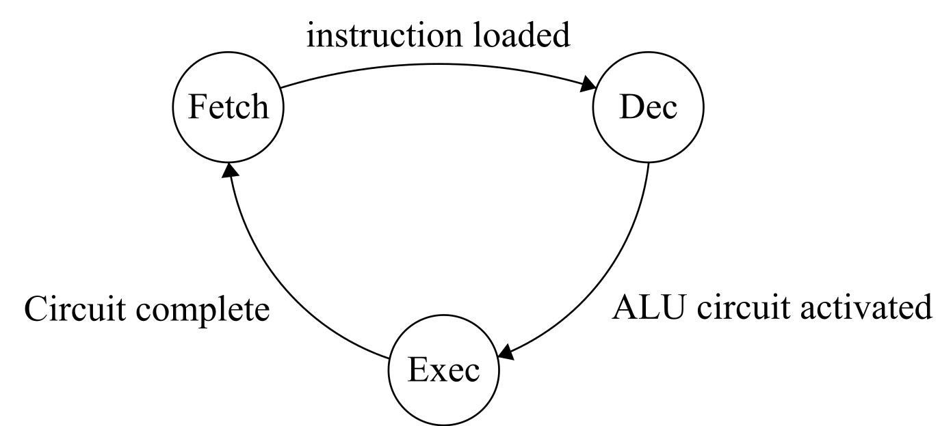
The Instruction Cycle
A computer executes a program one instruction at a time, according to the instruction cycle:
Fetch
Decode
Execute
Notes:
This is a simplified instruction cycle. It does not allow anything to happen in parallel, and ignores some hidden steps. We’ll discuss these later.

Slide 5
The Instruction Cycle
Fetch:
Instruction fetch: Load the instruction from memory
Operand fetch: Load the operand(s) from memory (if any)

Slide 6
The Instruction Cycle
Decode:
Control unit
Activate the circuit (e.g. in the ALU) to perform the requested operation
De-activate all other circuitry
Activate the registers to be used for input operands
Activate the registers to be used for the result of the operation
De-activate all other registers
Notes:
Decoding is a matter of identifying which operation is being requested (e.g. ADD), and
which operands (if any) are to be used (e.g. Registers A and B).

Slide 7
The Instruction Cycle
Execute:
Allow the data to pass:
From the input registers
Through the activated ALU circuit
Into the output register
Notes:
We’ve essentially covered this part of the cycle in the combinational logic lectures

Slide 8
A Simple Computer System
Hypothetical Academic Computer System (HAX)
Simple, RISC-style, instruction set
Each instruction has a 4-bit opcode, 4-bits of padding, and 8-bits of operand
256 word memory (8-bit words), total of 256 bytes of memory
8-bit data path
Seven 8-bit general-purpose registers (A, B, C, D, E, F, and G)
Special-purpose registers:
PC: Program counter (address of the next instruction)
IR: Instruction register (stores the instruction opcode)
MAR: Memory address register (the address in memory for read/write)
MBR: Memory buffer register (the data to be written, the data read)
FLAGS: Zero, Greater Than, Carry, Overflow
Notes:
For the purposes of this course, we’ll design a basic computer system. We’ll talk more about RISC later, but for now, RISC machines have fewer instructions (e.g. variants of ADD that get their operands from memory).

Slide 9
The Data Path
CSCI 2050U - Computer Architecture
Randy J. Fortier
@randy_fortier

Slide 10
Buses
A bus is similar to a wire or a connection
The key difference is that a bus has several parallel paths
e.g. Imagine an 8-bit bus between register A and register B
In₀
Out₀
In₀
Out₀
A
8-bit register
B
8-bit register
In₁
Out₁
In₁
Out₁
In₂
Out₂
In₂
Out₂
In₃
Out₃
In₃
Out₃
In₄
Out₄
In₄
Out₄
In₅
Out₅
In₅
Out₅
In₆
Out₆
In₆
Out₆
In₇
Out₇
In₇
Out₇
Notes:
While not a particularly useful bus, this does allow the value in the register A to be transferred to the register B.
Such register transfers are extremely important behaviours in a CPU.

Slide 11
Buses
A bus is very rarely point to point
Usually, there are more than 2 components connected to the bus
The bus is a shared medium
We need some mechanism to control what goes onto the bus
In₀
Out₀
In₀
Out₀
In₁
A
8-bit register
Out₁
In₁
B
8-bit register
Out₁
In₂
Out₂
In₂
Out₂
In₃
Out₃
In₃
Out₃
In₄
Out₄
In₄
Out₄
In₅
Out₅
In₅
Out₅
In₆
Out₆
In₆
Out₆
In₇
Out₇
In₇
Out₇
Notes:
We’ll talk about more of these contention mechanisms later in this section, but for now we have a tool for this purpose already (discussed in section 04).

Slide 12
The Data Path: A Shared Bus
IR
?
MAR
?
MBR
?
...
B
?
A
?
?
ALU
Notes:
Here we see the data path, the registers, and the ALU. The mystery component is what we need to control writes to the bus. We can use a similar component to control reads to the bus, as well, but most registers have a Write Enable input which makes this unnecessary.

Slide 13
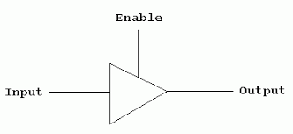
The Data Path: A Shared Bus
It isn’t really a problem if more than one component reads from the bus simultaneously
It is only a problem when more than one component writes to the bus simultaneously
The signals collide, producing a distorted (unrecognizable) signal
We block data going onto the bus using a tri-state buffer:

Slide 14
The Data Path: A Shared Bus
Here are our tri-state buffer components
Enable
Notes:
All of the tri-state buffers are enabled with the same input.

Slide 15
The Data Path: A Shared Bus
Here are our tri-state buffer components
Output
Enable
Enable

Slide 16
The Data Path: A Shared Bus
IR
OE
IE
MAR
OE
IE
MBR
OE
IE
...
B
OE
IE
A
OE
IE
OE
ALU
Notes:
This is the same data path, using a simpler notation. OE is short for our output enable component.

Slide 17
The Data Path: The Simplest Instruction (MOV)
Let’s consider the simplest instruction:
MOV A, B
Move the value from the register B into the register A
IR
OE
0
IE
0
MAR
OE
0
IE
0
MBR
OE
0
IE
...
0
B
OE
0
IE
1
A
OE
1
IE
0
OE
0
ALU
Notes:
This instruction would not enable any logic inside the ALU. The input enable of the A register would be set, and the input enables for all of the other registers would be cleared. The output enable of the B register would be set, and the rest of the output enables would be cleared. One clock cycle later, and our operation is done!

Slide 18
The Data Path: An Arithmetic Instruction (ADD)
Let’s consider the simplest instruction:
ADD A, B
Add the value from the register B to the register A, storing the result in A
IR
OE
0
IE
0
MAR
OE
0
IE
0
MBR
OE
0
IE
...
0
B
OE
0
IE
1
A
OE
1
IE
0
OE
0
ALU
Cycle 1
Notes:
This instruction will take two clock cycles. First, we enable the twos complement addition logic inside the ALU, likely a bubble carry adder. The output enable of the B register would be set, and the rest of the output enables would be cleared. The value of B is on the bus/data path. The value of A is piped directly into the ALU. The ALU computes the sum, but its output is initially blocked by the output enable.

Slide 19
The Data Path: An Arithmetic Instruction (ADD)
Let’s consider the simplest instruction:
ADD A, B
Add the value from the register B to the register A, storing the result in A
IR
OE
0
IE
0
MAR
OE
0
IE
0
MBR
OE
0
IE
...
0
B
OE
0
IE
0
A
OE
1
IE
0
OE
1
ALU
Cycle 2
Notes:
On the second clock cycle, the output enable for B is cleared, and the output enable for the ALU is set. Now, the sum is on the data path. The input enable for A is set, and the sum is loaded into A.

Slide 20
Register Transfer Language (RTL)
Many instructions can be written in RTL, which helps explain what the instructions do
These RTL instructions are also called microoperations (or microcode)
It isn’t necessarily the case that the hardware implements these RTL instructions directly, but most processors do support them
Example (MOV A, B)
A ← B
PC ← PC + 2
IR ← M[PC]

Slide 21
Fetch
CSCI 2050U - Computer Architecture
Randy J. Fortier
@randy_fortier

Slide 22
Executing Instructions
Every instruction needs additional housekeeping:
Before: The instruction needs to be fetched from memory
After: The program counter needs to be updated

Slide 23
Instruction Fetch
Instruction fetch:
PC
OE
0
1
IR
OE
0
IE
0
MAR
OE
1
IE
0
MBR
OE
0
IE
...
0
B
OE
0
IE
0
A
OE
0
IE
0
OE
0
ALU
Cycle 1
Notes:
The PC register contains the address of the next instruction, which needs to be loaded into IR. Memory reads will work by loading the address to be read into MAR, and the value will be loaded into MBR. The steps, therefore, will be: 1) Transfer PC into MAR, 2) Memory load, 3) Transfer MBR into IR
A note on implementation: The MBR register would have its outputs and inputs connected to the data lines of the CPU/RAM bus. The MAR register would have its inputs/outputs connected to the address lines of the CPU/RAM bus.

Slide 24
Instruction Fetch
Instruction fetch:
PC
OE
0
0
IR
OE
1
IE
0
MAR
OE
0
IE
0
MBR
OE
0
IE
...
1
B
OE
0
IE
0
A
OE
0
IE
0
OE
0
ALU
Cycle 2
Notes:
The PC register contains the address of the next instruction, which needs to be loaded into IR. Memory reads will work by loading the address to be read into MAR, and the value will be loaded into MBR. The steps, therefore, will be: 1) Transfer PC into MAR, 2) Memory load, 3) Transfer MBR into IR
A note on implementation: The MBR register would have its outputs and inputs connected to the data lines of the CPU/RAM bus. The MAR register would have its inputs/outputs connected to the address lines of the CPU/RAM bus.

Slide 25
Increment Program Counter
Increment program counter:
PC
OE
0
IE
1
IR
OE
0
IE
0
MAR
OE
0
IE
0
MBR
OE
0
IE
...
0
B
OE
0
IE
0
A
OE
0
IE
0
OE
0
ALU
Cycle 1
Notes:
The program counter is usually incremented by a constant amount (some instruction sets have variable sized instructions). Our instructions are two 8-bit words in size (1 - opcode, 1 - operand), so we increase PC by 2. If we implement PC with a counter register, we merely need to enable counting on that register for two clock cycles. Alternatively, we could use the ALU to add 2 to PC. We could also make the word size 16.

Slide 26
Increment Program Counter
Increment program counter:
PC
OE
1
IE
0
IR
OE
0
IE
0
MAR
OE
0
IE
0
MBR
OE
0
IE
...
0
B
OE
0
IE
0
A
OE
0
IE
0
OE
1
ALU
Cycle 2
Notes:
The program counter is usually incremented by a constant amount (some instruction sets have variable sized instructions). Our instructions are two 8-bit words in size (1 - opcode, 1 - operand), so we increase PC by 2. If we implement PC with a counter register, we merely need to enable counting on that register for two clock cycles. Alternatively, we could use the ALU to add 2 to PC. We could also make the word size 16.

Slide 27
Memory Load
In a RISC processor, memory loads are usually limited, e.g.:
LOAD B
Load the value into A from the memory address found in B
PC
OE
0
IE
0
0
IR
OE
IE
0
MAR
OE
1
IE
0
MBR
OE
0
IE
...
0
B
OE
0
IE
1
A
OE
0
IE
0
OE
0
ALU
Cycle 1
Notes:
CISC processors allow instructions like ADD to get their operands from registers, memory, etc. RISC, like ours, usually do not. We’ll use a dedicated LOAD instruction. This instruction will: 1) Transfer B into MAR, 2) Perform memory load, 3) Transfer MBR to A
Operand fetch (in a CISC processor) is very similar.

Slide 28
Memory Load
In a RISC processor, memory loads are usually limited, e.g.:
LOAD B
Load the value into A from the memory address found in B
PC
OE
0
IE
0
0
IR
OE
IE
0
MAR
OE
0
IE
0
MBR
OE
0
IE
...
1
B
OE
0
IE
0
A
OE
1
IE
0
OE
0
ALU
Cycle 2
Notes:
CISC processors allow instructions like ADD to get their operands from registers, memory, etc. RISC, like ours, usually do not. We’ll use a dedicated LOAD instruction. This instruction will: 1) Transfer B into MAR, 2) Perform memory load, 3) Transfer MBR to A
Operand fetch (in a CISC processor) is very similar.

Slide 29
Memory Store
In a RISC processor, memory stores are also usually limited, e.g.:
STORE B
Store the value in A into the memory address found in B
PC
OE
0
IE
0
0
IR
OE
IE
0
MAR
OE
0
IE
0
MBR
OE
1
IE
...
0
B
OE
0
IE
0
A
OE
0
IE
1
OE
0
ALU
Cycle 1
Notes:
This instruction will: 1) Transfer B into MAR, 2) Transfer A into MBR, 3) Perform memory save

Slide 30
Memory Store
In a RISC processor, memory stores are also usually limited, e.g.:
STORE B
Store the value in A into the memory address found in B
PC
OE
0
IE
0
0
IR
OE
IE
0
MAR
OE
1
IE
0
MBR
OE
0
IE
...
0
B
OE
0
IE
1
A
OE
0
IE
0
OE
0
ALU
Cycle 2
Notes:
This instruction will: 1) Transfer B into MAR, 2) Transfer A into MBR, 3) Perform memory save

Slide 31
Decode
CSCI 2050U - Computer Architecture
Randy J. Fortier
@randy_fortier

Slide 32
Decoding Instructions
Decoding involves the following:
Determine which (e.g. arithmetic) operation is to be performed
Determine which registers (or memory, constants) are to be used for the operands

Slide 33
Decoding Instructions
Decoding involves the following:
Determine which (e.g. arithmetic) operation is to be performed
The first 4 bits of our instruction are the opcode
These are fed into a 4-to-16 line decoder
The outputs of this decoder will be fed into enable inputs for the ALU circuits
Determine which registers (or memory, constants) are to be used for the operands
Adder
4-to-16
DEC
Subtracter
...
Notes:
It is easy to imagine using all 8-bits for instructions, as our HAX instruction set is quite limited.

Slide 34
Decoding Instructions
0001 | A
0010 | B
0011 | C
0100 | D
0101 | E
0110 | F
0111 | G
Decoding involves the following:
Determine which (e.g. arithmetic) operation is to be performed
Determine which registers (or memory, constants) are to be used for the operands
The first 4 bits of the operand identify the type of the first operand
000 - Constant
001 - register A
010 - register B (etc.)
The next 4 bits of the operand are for the second operand
These will activate the input and output enables for the registers
This might also use a decoder
The operand could also be a single constant
o | pc | od | e | 0 | 0 | 0 | 0 | 0 | o | p | 1 | 0 | o | p | 2
o | pc | od | e | 0 | 0 | 0 | 0 | c | o | n | s | t | a | n | t
Notes:
If we had 8 general-purpose registers, we would need 4 bits per operand since one of the codes needs to be for constants. For 7 general-purpose registers, we only need 3 bits. We've set aside 4 bits but will only use the lowest 3 bits. Each of these 3-bit operand codes would be fed into a 3-to-8 line decoder, (all but one of) the outputs of which would be connected to the output enable and/or input enable of each of the 7 registers.

Slide 35
Execute
CSCI 2050U - Computer Architecture
Randy J. Fortier
@randy_fortier

Slide 36
HAX Instruction Set: RTL
MOV A, B | A ← B PC ← PC + 2 IR ← M[PC]
ADD A, B | A ← A + B PC ← PC + 2 IR ← M[PC]
SUB A, B | A ← A - B PC ← PC + 2 IR ← M[PC]
Notes:
For the MOV instruction, B can be a register or it can be a constant. The constant can be 8-bits.

Slide 37
HAX Instruction Set: RTL
LOAD B | MAR ← B MBR ← M[MAR] A ← MBR PC ← PC + 2 IR ← M[PC]
STORE B | MAR ← B MBR ← A M[MAR] ← MBR PC ← PC + 2 IR ← M[PC]

Slide 38
HAX Instruction Set: RTL
JMP A | PC ← A IR ← M[PC]
JZ A | IF FLAGS[Z] == 1 THEN PC ← A ELSE PC ← PC + 2 IR ← M[PC]
JNZ A | IF FLAGS[Z] == 0 THEN PC ← A ELSE PC ← PC + 2 IR ← M[PC]

Slide 39
HAX Instruction Set
Binary | Mnemonic | Operand(s) | Description
0000 | HALT | - | Stops execution
0001 | MOV | dest, source | Copies the value from source to dest
0010 | LOAD | addr | Loads value from memory at addr into A
0011 | STORE | addr | Stores value from A into memory at addr
0100 | ADD | dest, source | dest = dest + source
0101 | SUB | dest, source | dest = dest - source
...
1000 | JMP | addr | Jumps to addr
1001 | JZ | addr | If the zero flag is set, jumps to addr
1010 | JNZ | addr | If the zero flag is cleared, jumps to addr
...

Slide 40
A Test Program
Let’s write a HAX assembly language program:
00: LOAD 0C (LOAD X)
02: MOV B, A
04: LOAD 0D (LOAD Y)
06: ADD A, B
08: STORE 0E (STORE Z)
0A: HALT
0C: 0x04 (X: 4)
0D: 0xFE (Y: -2)
0E: 0x00 (Z: 0)

Slide 41
A Test Program
Let’s trace our HAX assembly language program:
X Y Z
Instr | RTL | Registers |  |  |  |  |  | Memory
 |  | A | B | PC | IR | MAR | MBR | 0C | 0D | 0E
Initial | - | ?? | ?? | 00 | 20 | ?? | ?? | 04 | FE | 00
LOAD 0C | MAR ← 0C MBR ← M[MAR] A ← MBR PC ← PC + 2 IR ← M[PC] | 04 | ?? | 02 | 10 | 0C | 04 | 04 | FE | 00
MOV B, A | B ← A PC ← PC + 2 IR ← M[PC] | 04 | 04 | 04 | 20 | 0C | 04 | 04 | FE | 00
Part 1

Slide 42
A Test Program
Let’s trace our HAX assembly language program:
Instr | RTL | Registers |  |  |  |  |  | Memory
 |  | A | B | PC | IR | MAR | MBR | 0C | 0D | 0E
LOAD 0D | MAR ← 0D MBR ← M[MAR] A ← MBR PC ← PC + 2 IR ← M[PC] | FE | 04 | 06 | 40 | 0D | FE | 04 | FE | 00
ADD A, B | A ← A + B PC ← PC + 2 IR ← M[PC] | 02 | 04 | 08 | 30 | 0D | FE | 04 | FE | 00
STORE 0E | MAR ← 0E MBR ← A M[MAR] ← MBR PC ← PC + 2 IR ← M[PC] | 02 | 04 | 0A | 00 | 0E | 02 | 04 | FE | 02
Part 2

Slide 43
Assembly
Assembly is the process of converting human-readable assembly language (with mnemonics) to machine-readable machine language (in binary)
Disassembly is just the opposite
For simplicity, I will use hexadecimal instead of binary

Slide 44
Assembly
Below shows the assembly of our test program:
00: LOAD 0C 00: 210C
02: MOV B, A 02: 1021 (B:0010 A:0001, 00100001, 33, 0x21)
04: LOAD 0D 04: 210D
06: ADD A, B 06: 4012 (A:0001 B:0010, 00010010, 18, 0x12)
08: STORE 0E 08: 310E
0A: HALT 0A: 0000
0C: 0x04 (4) 0C: 04FE
0D: 0xFE (-2)
0E: 0x00 (0) 0E: 00??
0001 | A
0010 | B
0011 | C
0100 | D
0101 | E
0110 | F
0111 | G

Slide 45
Two-stage Assembly
Two-stage assembly can make our program more readable
Use named locations for data (i.e. variables)
Use named locations for jumps (i.e. labels)
The stages:
Replace any symbols with the address of the symbol
Replace mnemonics and operands with binary equivalents (as before)

Slide 46
Two-stage Assembly
Below shows the assembly of our test program:
00: LOAD X LOAD 0C 210C
02: MOV B, A MOV B, A 1021
04: LOAD Y LOAD 0D 210D
06: ADD A, B ADD A, B 4012
08: STORE Z STORE 0E 310E
0A: HALT HALT 0000
0C: INT X = 4 (0x04) 0x04 04FE
0D: INT Y = -2 (0xFE) 0xFE
0E: INT Z = 0 (0x00) 0x00 00??
stage 1
stage 2

Slide 47
A More Complex Program
Here is a program that loops over an array of numbers, adding pairs of them:
00: MOV D, increment
02: LOAD D
04: MOV D, A
08: MOV E, count
0A: LOAD E
0C: MOV E, A
0E: MOV C, numbers
loopStart: 10: LOAD C
12: MOV B, A
14: ADD C, D
16: LOAD C
18: ADD A, B
1A: ADD C, D
1C: STORE C
1E: ADD C, D
20: SUB E, D
22: JNZ loopStart
24: HALT
increment: 26: INT 1
count: 27: INT 2
numbers: 28: INT 4
29: INT -2
2A: INT 0
2B: INT -6
2C: INT 4
2D: INT 0

Slide 48
A More Complex Program
Some assemblers have these aliases which make comparisons/jumps easier to understand:
00: MOV D, increment
02: LOAD D
04: MOV D, A
08: MOV E, count
0A: LOAD E
0C: MOV E, A
0E: MOV C, numbers
loopStart: 10: LOAD C
12: MOV B, A
14: ADD C, D
16: LOAD C
18: ADD A, B
1A: ADD C, D
1C: STORE C
1E: ADD C, D
20: CMP E, D
22: JNE loopStart
24: HALT
increment: 26: INT 1
count: 27: INT 2
numbers: 28: INT 4
29: INT -2
2A: INT 0
2B: INT -6
2C: INT 4
2D: INT 0

Slide 49
Optimizations
CSCI 2050U - Computer Architecture
Randy J. Fortier
@randy_fortier

Slide 50
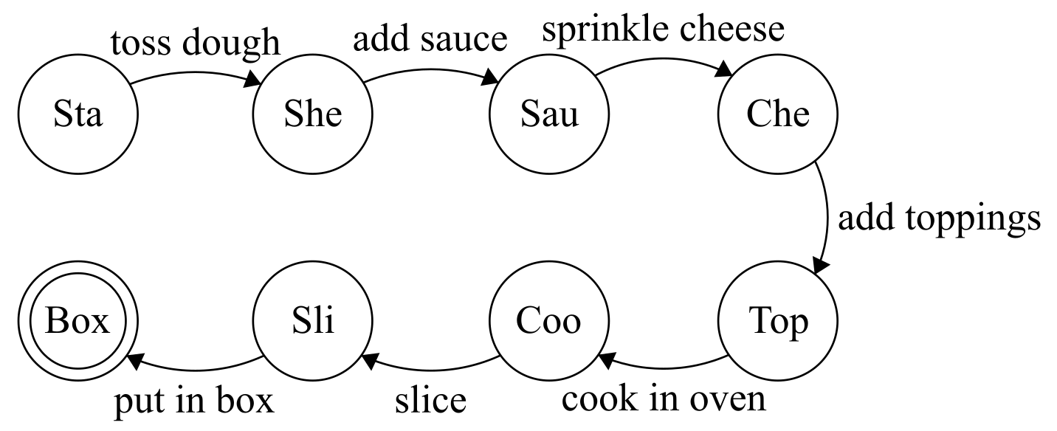
Pipelining
Imagine you work at a pizza place, making pizzas:
Toss the dough
Add sauce
Sprinkle cheese
Add toppings
Cook in oven
Slice
Box
When not busy, you might:
Notes:
In this case, there isn’t much else you can do. This is the fastest way to make one pizza.

Slide 51
Pipelining
What if it is busy?
Notes:
What would do you differently if it was busy?

Slide 52
Pipelining
What if it is busy?
The pizza takes a long time to cook in the oven, and you can’t really do anything useful until it has finished
Parallelism - while the first pizza is in the oven, you can start the second pizza
Notes:
You’d quickly be fired if you waited by the oven for each pizze to be ready without doing anything else.

Slide 53
Pipelining
What if it is busy?
The pizza takes a long time to cook in the oven, and you can’t really do anything useful until it has finished
Parallelism - while the first pizza is in the oven, you can start the second pizza
This is quite similar to executing instructions in a CPU
Fetch the instruction and operand values
Decode the instruction
Execute the instruction
Notes:
Like cooking the pizza in the oven, fetching instructions and operand values take a long time. During this time, the ALU (and other CPU components) are idle.

Slide 54
Pipelining
Without pipelining
Fetch the opcode and operand values for the first instruction
Fetch
Decode
Execute

Slide 55
Pipelining
Without pipelining
Fetch the opcode and operand values for the first instruction
Decode the first instruction
Fetch
Decode
Execute

Slide 56
Pipelining
Without pipelining
Fetch the opcode and operand values for the first instruction
Decode the first instruction
Execute the first instruction
Fetch
Decode
Execute

Slide 57
Pipelining
Without pipelining
Fetch the opcode and operand values for the first instruction
Decode the first instruction
Execute the first instruction
Fetch the opcode and operand values for the second instruction
Fetch
Decode
Execute

Slide 58
Pipelining
Without pipelining
Fetch the opcode and operand values for the first instruction
Decode the first instruction
Execute the first instruction
Fetch the opcode and operand values for the second instruction
etc.
Fetch
Decode
Execute

Slide 59
Pipelining
Without pipelining
Fetch the opcode and operand values for the first instruction
Decode the first instruction
Execute the first instruction
Fetch the opcode and operand values for the second instruction
etc.
Fetch
Decode
Execute

Slide 60
Pipelining
Without pipelining
Fetch the opcode and operand values for the first instruction
Decode the first instruction
Execute the first instruction
Fetch the opcode and operand values for the second instruction
etc.
Fetch
Decode
Execute

Slide 61
Pipelining
Without pipelining
Fetch the opcode and operand values for the first instruction
Decode the first instruction
Execute the first instruction
Fetch the opcode and operand values for the second instruction
etc.
Fetch
Decode
Execute
Notes:
Assuming that each step takes one clock cycle, after 8 clock cycles we’ve completed two instructions (almost 3, 2.6666).

Slide 62
Pipelining
Without pipelining
Fetch the opcode and operand values for the first instruction
Decode the first instruction
Execute the first instruction
Fetch the opcode and operand values for the second instruction
etc.
Fetch
Decode
Execute
Notes:
For completeness, this is the next clock cycle

Slide 63
Pipelining
Pipelining in action
Fetch the opcode and operand values for the first instruction
Fetch
Decode
Execute

Slide 64
Pipelining
Pipelining in action
Fetch the opcode and operand values for the first instruction
Decode the first instruction, and fetch the second
Fetch
Decode
Execute

Slide 65
Pipelining
Pipelining in action
Fetch the opcode and operand values for the first instruction
Decode the first instruction, and fetch the second
Execute the first, decode the second, and fetch the third
Fetch
Decode
Execute

Slide 66
Pipelining
Pipelining in action
Fetch the opcode and operand values for the first instruction
Decode the first instruction, and fetch the second
Execute the first, decode the second, and fetch the third
etc.
Fetch
Decode
Execute

Slide 67
Pipelining
Pipelining in action
Fetch the opcode and operand values for the first instruction
Decode the first instruction, and fetch the second
Execute the first, decode the second, and fetch the third
etc.
Fetch
Decode
Execute

Slide 68
Pipelining
Pipelining in action
Fetch the opcode and operand values for the first instruction
Decode the first instruction, and fetch the second
Execute the first, decode the second, and fetch the third
etc.
Fetch
Decode
Execute

Slide 69
Pipelining
Pipelining in action
Fetch the opcode and operand values for the first instruction
Decode the first instruction, and fetch the second
Execute the first, decode the second, and fetch the third
etc.
Fetch
Decode
Execute

Slide 70
Pipelining
Pipelining in action
Fetch the opcode and operand values for the first instruction
Decode the first instruction, and fetch the second
Execute the first, decode the second, and fetch the third
etc.
Fetch
Decode
Execute
Notes:
Assuming each step takes one clock cycle, after 8 clock cycles we’ve completed 5 instructions.

Slide 71
Pipelining
But...
Pipelining breaks down on branch/jump instructions
Pipelining may break down if a subsequent instruction requires the values from a previous instruction
Notes:
What if you get to a JNZ instruction? Which instruction is the next instruction? The one after the JNZ instruction, or the one at the jump address? Imagine a program that manipulates pointers. An instruction may dereference a pointer that was modified by an earlier instruction.

Slide 72
Pipelining
Branch prediction
The CPU guesses which path the program will take, and pre-executes the instructions along that execution path
e.g. If a branch has been true for the past 10 iterations of the loop, let’s assume it will be true again this time
If it guesses wrong, it may need to undo everything it has done since the branch

Slide 73
Multi-core CPUs and GPUs
Multi-core CPUs have become the standard for most devices
These are CPUs with multiple physical processing units
Multiple ALUs, multiple control units, multiple register sets
GPUs are similar, except they have far more numerous, but simpler, cores
These multi-core systems will be examined further in a future lecture

Slide 74
Hyper-threading
As we’ve seen, adjacent instructions are often dependent
Instruction A modifies a value used by instruction B
It may not be possible for pipelining to pre-execute instruction B, since the values it needs are not yet ready
Hyper-threading solves this problem by introducing k logical cores
Each physical core may be mapped to k logical cores (e.g. 2)
A logical core looks like a core to the operating system
The CPU may interleave instructions from separate processes/threads in the same core, since they are more likely to be independent

Slide 75
Hyper-threading
Process 1, Logical core 1
Process 2, Logical core 2
Physical core

Slide 76
Hyper-threading
Process 1, Logical core 1
Process 2, Logical core 2
Physical core

Slide 77
Hyper-threading
Process 1, Logical core 1
Process 2, Logical core 2
Physical core
Notes:
Though difficult to depict in this animation, these two instructions would be pipelined.

Slide 78
Hyper-threading
Process 1, Logical core 1
Process 2, Logical core 2
Physical core

Slide 79
Hyper-threading
Process 1, Logical core 1
Process 2, Logical core 2
Physical core

Slide 80
Hyper-threading
Process 1, Logical core 1
Process 2, Logical core 2
Physical core

Slide 81
Hyper-threading
Process 1, Logical core 1
Process 2, Logical core 2
Physical core
Notes:
An additional advantage of hyper-threading is that instructions reading from memory, which typically takes several clock cycles, can block while the other thread can continue to execute. The sharing of the physical core doesn’t have to use strict interleaving, as shown here.
See: Task Manager -> Performance

Slide 82
Peripheral Buses
CSCI 2050U - Computer Architecture
Randy J. Fortier
@randy_fortier

Slide 83
Peripheral Buses
Computers have other components for them to be useful:
RAM
Keyboards
Monitors
Printers
Touch screens
GPUs

Slide 84
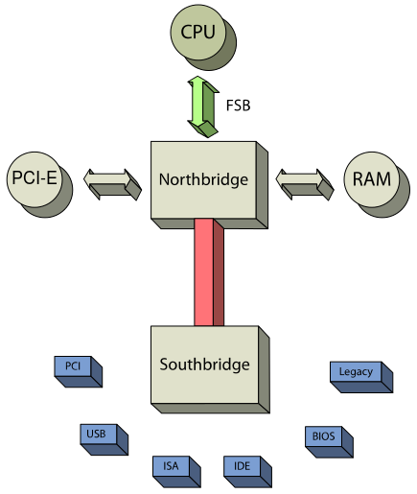
Peripheral Buses
Computers have other components for them to be useful:
RAM (RAMBUS via FSB)
Keyboards (USB)
Monitors (PCI-e)
Printers (USB)
Touch screens (PCI-e)
GPUs (PCI-e)
Notes:
We’ve previously looked at the data path, also called the back side bus, which exists entirely within the CPU. In this diagram, we can see the front side bus, which connects the CPU to its RAM (and on PCs, also to the PCI-e bus; a bus connected via a bus). This whole system is controlled by the northbridge controller chip on the motherboard. A faster FSB means faster access to memory, and faster memory being supported.

Slide 85
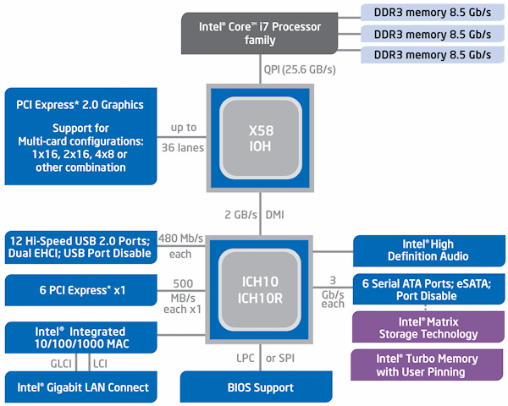
Peripheral Buses
As an aside, modern processors often bypass the FSB for RAM:
Notes:
Intel’s latest processors have a dedicated bus between the CPU and RAM, called QPI (Quick Path Interconnect), to speed RAM access even further.

Slide 86
Peripheral Buses
Computers have other components for them to be useful:
RAM (RAMBUS via FSB)
Keyboards (USB)
Monitors (PCI-e)
Printers (USB)
Touch screens (PCI-e)
GPUs (PCI-e)
Notes:
The northbridge controller chip also connects to another controller chip: southbridge. This controller allows communication with lower-throughput devices, like USB. The CPU can connect to a USB device through the FSB to the northbridge, between northbridge and southbridge, then over the USB bus to the peripheral. More direct → Lower latency.

Slide 87

Peripheral Buses
Peripheral Component Interconnect Express (PCI-e) is used for peripherals inside the PC case (mainly, GPUs)
Legacy PCI used a shared bus with a round-robin access protocol
PCI-e, in contrast, implements a point-to-point protocol
All devices have direct connections with each other
There is no contention, as it is not a shared bus
PCI-e also is closer to the CPU and RAM, resulting in faster communication
Notes:
PCI-e devices, like GPUs, typically require high throughput (lots of bits transferred per second) and low latency (short times for data to go from source to destination). 1) A point-to-point protocol eliminates the need for any turn-taking, 2) Being one hop away from the CPU and RAM, the components GPUs communicate with most frequently, allows for fewer delays. It comes at a cost, however. PCI-e being point-to-point is expensive, and does occupy some RAM/CPU, so more devices could mean more slowdown.

Slide 88

Peripheral Buses
Universal Serial Bus (USB) is meant for peripherals outside of the PC
These devices are generally slower, e.g.
External hard disks
Keyboard
Mouse
Printer
USB is a shared bus, and uses a master/slave protocol to control access to the bus
The host PC is the master, and determines which device does what and when

Slide 89
Wrap-Up
Instruction cycle
Data path
Memory fetch, instruction fetch
Control unit, instruction decoding
Pipelining and hyperthreading
Peripheral buses (e.g. USB, PCI-e)
Contention

